Slide 1

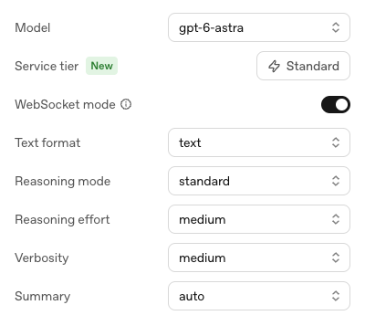
OpenAI Playground
Test API prompts
in your browser.
Use the same prompt to compare
models. Adjust reasoning effort
and the output format.
Test the reply in your browser.
Move to code when it works.
Open OpenAI Playground
Notes:
A playground lets a developer test an API request through a browser before building the surrounding application. Show the model selector in this screenshot and run the same small task on two models available to the account. Inspect the answers against the same criteria. The reasoning effort and output controls are useful examples of settings to explore; supported settings vary by model. Keep the input fixed while changing one setting so the comparison is easy to explain. The selected model in the screenshot is a dated example, not a recommendation or a guarantee that every account can use it. Playground calls use API billing, separately from a ChatGPT subscription. Screenshot supplied by James, captured 1 October 2026.
Sources:
https://platform.openai.com/chat/edit
https://developers.openai.com/api/docs/guides/prompt-engineering
https://help.openai.com/en/articles/9039756-managing-billing-for-chatgpt-and-the-api-platform

Slide 2
Prototype a Customer Support Reply
Try this review
“The mug looks lovely, but its handle
broke on the first day.”
Give the model a clear job
Write a two-sentence reply.
Acknowledge the fault. Do not promise a refund.
Try another review. Check the fault is acknowledged.
Prompting guidance
Notes:
Paste the review into the conversation and use the two-sentence instruction as the prompt guidance. Run it and inspect whether the reply acknowledges the broken handle without promising a refund. Edit the instructions and rerun the same review. Then try a different review, such as a late delivery or a compliment. This is rapid prototyping: we can learn whether a proposed feature produces useful output before writing its interface and integration. The slide contains a teaching prompt, not a recorded model output. Use several examples before treating the prompt as ready for the application. Students can follow this experiment entirely in the browser.
Sources:
https://platform.openai.com/chat/edit
https://developers.openai.com/api/docs/guides/prompt-engineering

Slide 3

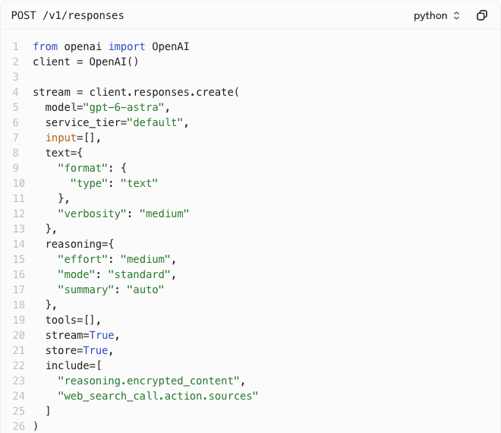
Export the Request as Python
Click Code
Export the model, settings
and tools as a Python snippet.
Add your input and API key.
Run it in your application.
This draft has input=[] (empty).
Python API quickstart
Notes:
Use the Code button in the top right of the Playground to inspect code for the current prompt and configuration. The supplied View code screenshot shows a Python SDK request to the Responses API, including the model, output settings, reasoning configuration and streaming option. It provides integration code for the configuration; it does not build the rest of the application. This screenshot was taken from an empty draft, so input=[] contains no task and tools=[] enables no tools. Add prompt guidance and a user message before exporting a useful request, or fill those fields deliberately in the Python code. Install the SDK and supply the API key through an environment variable or secret manager. The full screenshot continues into a streaming event loop; our crop focuses on the request settings. Do not assume the pictured model and every setting are supported by all accounts or models. Screenshot supplied by James, captured 1 October 2026.
Sources:
https://developers.openai.com/api/docs/quickstart
https://platform.openai.com/chat/edit

Slide 4
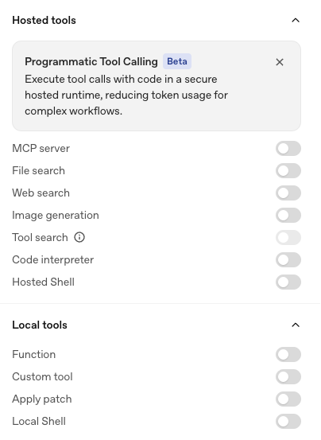
Hosted Tools and Local Tools
Hosted tools
Search, image generation and Python
run through OpenAI-hosted tools.
Hosted Shell runs in a container.
Local tools
Your app runs functions, custom
tools, patches and shell commands.
It sends results back to the model.
Local can mean your backend server.
MCP tools run on the connected server.
Tool execution guide
Notes:
The menus distinguish hosted tools from tools that need execution in your application. OpenAI handles its built-in hosted tools, such as web search, file search and image generation. Code Interpreter executes Python in a sandbox, and hosted shell uses an OpenAI-managed container. Programmatic Tool Calling, shown above the list in the full supplied screenshot, uses a hosted JavaScript runtime to orchestrate tool calls; it is different from Code Interpreter and still needs the appropriate execution mechanism for each called tool. Local functions, custom tools, apply-patch requests and local shell actions are requests for your integration to handle. The model asks for work, your application performs it, and your application returns the results. Local can mean a backend server or another environment you control, rather than the student’s laptop. MCP appears in the hosted menu, but remote MCP tool execution occurs on the connected MCP server. Choosing a local tool does not give the Playground permission to execute arbitrary code on your machine. The screenshot shows both tool menus in full. Screenshot supplied by James, captured 1 October 2026.
Sources:
https://developers.openai.com/api/docs/guides/tools
https://developers.openai.com/api/docs/guides/function-calling
https://developers.openai.com/api/docs/guides/tools-shell
https://developers.openai.com/api/docs/guides/tools-code-interpreter
https://developers.openai.com/api/docs/guides/tools-programmatic-tool-calling
https://developers.openai.com/api/docs/guides/tools-connectors-mcp

